Slide 1

Hunter x Hunter or Made in Abyss?
A Flexible Anime Recommender System
Binh Hoang

Slide 2




Anime Streaming Wars
Global anime market valued at $20 bn in 2018 and growing
2018: Netflix purchased worldwide license for Neon Genesis Evangelion for estimated $3 mn

Slide 3
Recommender Systems as Competitive Edge
2020: Crunchyroll rolled out their recommender system to rival Netflix’s
Funimation: no recommender yet

Slide 4



Data
120,000
USER REVIEWS
1,000
TOP ANIME

Slide 5
Methodology
Web Scraping
Data Storage
Recommender
Visualizations
BeautifulSoup
Selenium
Docker
Google Cloud Platform
MongoDB (TBC)
Scikit-learn
Pandas
Numpy
Seaborn
Flask (TBC)

Slide 6




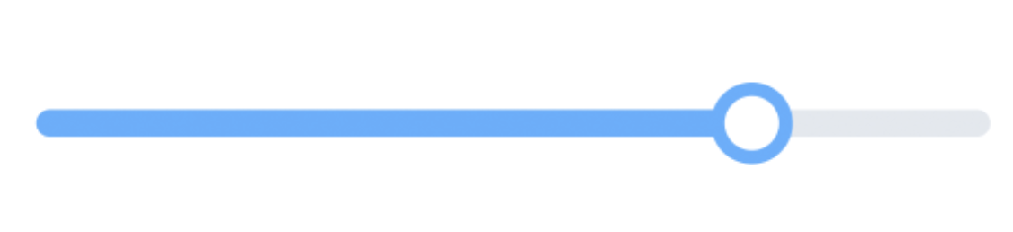
Recommender System Pipeline
Anime A: 10 points
Anime B: 6 points
Anime C: 12 points
.
.
.
Anime T: 8 points
Anime C: 12 points
Anime A: 10 points
Anime T: 8 points
.
.
.
Anime B: 6 points
Content-based Filtering
10 anime
20 anime
10 anime
10 anime
Collaborative
Filtering
Less Adventurous
More Adventurous
1,000
TOP ANIME
CANDIDATE GENERATION
SCORING
RE-RANKING
RECOMMENDATION

Slide 7
Flask App Demonstration (TBC)
Insert video

Slide 8





User alesyasabri1 Anime Profile
alesyasabri1
Watches a lot of shounen anime (66%)

Slide 9

Content-based Recommendation
Kuroko No Basuke
(another shounen anime)

Slide 10

Collaborative Filtering Recommendation
Mo Dao Zu Shi
(visually stunning mature action anime)

Slide 11
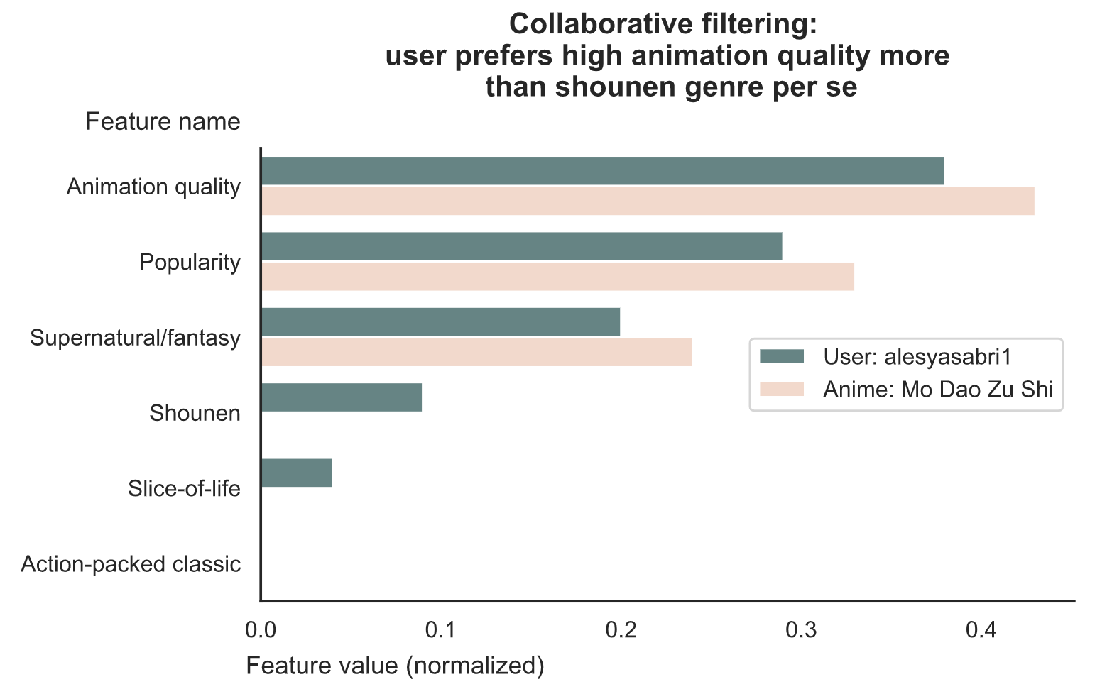
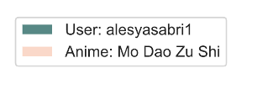

Slide 12


Conclusion: Give Users Flexibility
Less Adventurous
(content-based filtering)
Balanced
(mix of both)
More Adventurous
(collaborative filtering)

Slide 13
Future Work
Will add here depending on how much I can get done with my Flask app

Slide 14

Thank you
Binh Hoang
LinkedIn: binh748
GitHub: binh748
Images/data were sourced from the internet for educational purposes

Slide 15
More Future Work
Collate anime seasons/movies of a single anime into one listing so not recommending the same anime repeatedly (explain what I mean with an example)

